Slide 1


Preparing to apply for secondary school

Slide 2
Key dates and information
Applications:
Open 17 July 2023
Close 31 October 2023
Notification 1 March 2024
Some facts:
It is NOT first come first served
You can (and should) apply for up to 6 places.
You apply to the council you live in. This includes if you are applying for a school in a neighbouring borough.
Only list a grammar school as a preference if your child has sat the entrance test (results 20 October 2023)
Form cannot be changed once submitted.

Slide 3
How to apply
Check the admissions policy for each school
Available via each schools website (check policies section)
Check if your child meets the criteria
Look out for any additional requirements
For example Sandwell Academy, Shireland Collegiate Academy and West Bromwich Collegiate require your child to sit a non-verbal reasoning test after applications are submitted
www.sandwell.gov.uk
Click – schools and learning
Click – apply for a school place
DO NOT submit until you are 100% sure.

Slide 4
Schools with additional application forms
Aptitude:
George Salter (Arts Aptitude)
Shireland Collegiate Academy (Arts Aptitude)
Wood Green Academy (Sporting Aptitude)
Sandwell Academy (Sporting Aptitude)
Shireland CBSO (Musical Aptitude)
Windsor Olympus (Sporting Aptitude)
Denominational grounds
St Michael’s COFE High School
Stuart Bathurst Catholic High School
Medical grounds:
Holly Lodge High School
Oldbury Academy
Ormiston Community Sandwell Academy
Ormiston Forge Academy
Perryfields Academy
The Phoenix School
Wodensborough Ormiston Academy

Slide 5
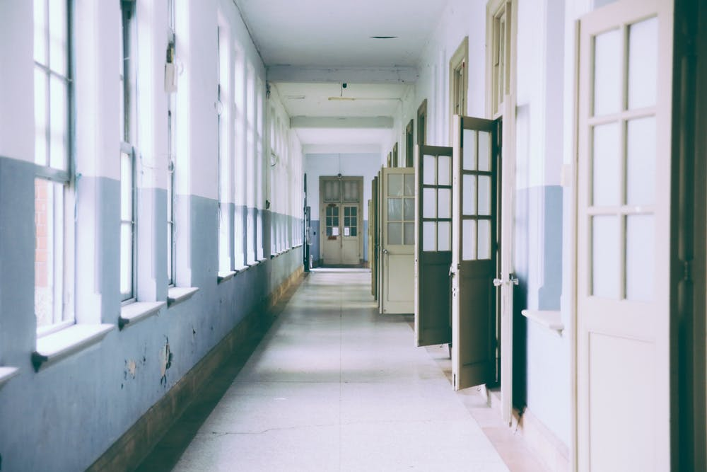
What to look for in a school

Slide 6

What to look for in a school

Slide 7
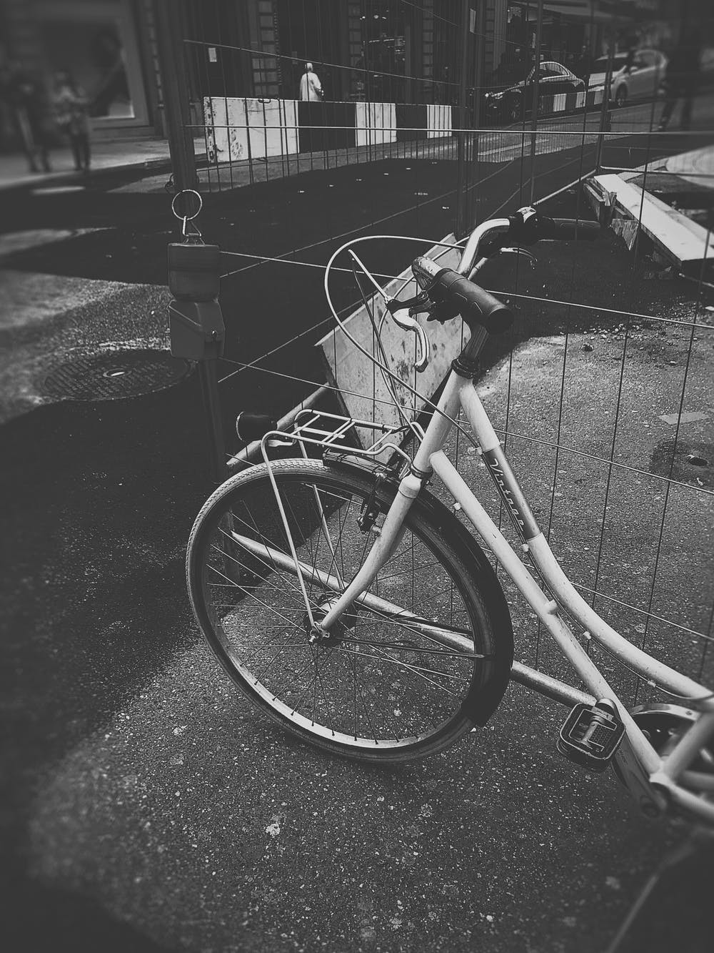


What to look for in a school

Slide 8


What to look for in a school

Slide 9

What to look for in a school

Slide 10

What else to consider

Slide 11
Appealing a school place
If you do not get the school you wanted:
Accept the place you have been given, even if it is not the school you want.
Download, complete and post appeals form (sandwell.gov.uk)
or appeal the decision online (My Sandwell)
You can only appeal for a place at a school that you put on your preference list
To appeal for Sandwell Academy, contact them directly
To appeal for a school outside of Sandwell you will need to contact the relevant local authority

Slide 12
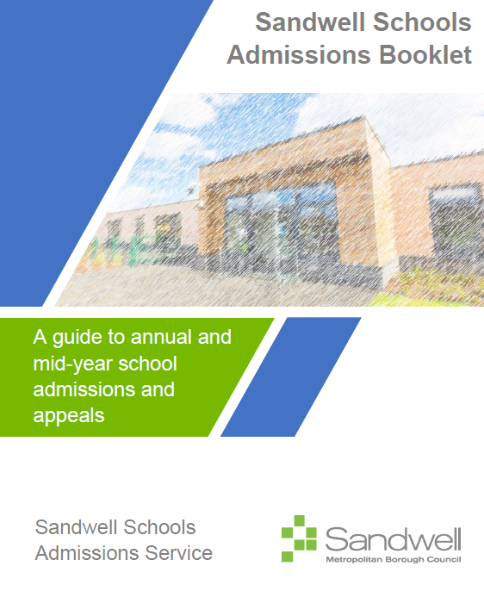
For more details
2024/25 Sandwell School Admissions Booklet available on the sandwell.gov.uk website:
Sandwell Schools Admission Booklet | Sandwell Council

Slide 13

Questions

